Slide 1
Cohen chap 1. Intro to Stats
For EDUC/PSY 6600

Slide 2
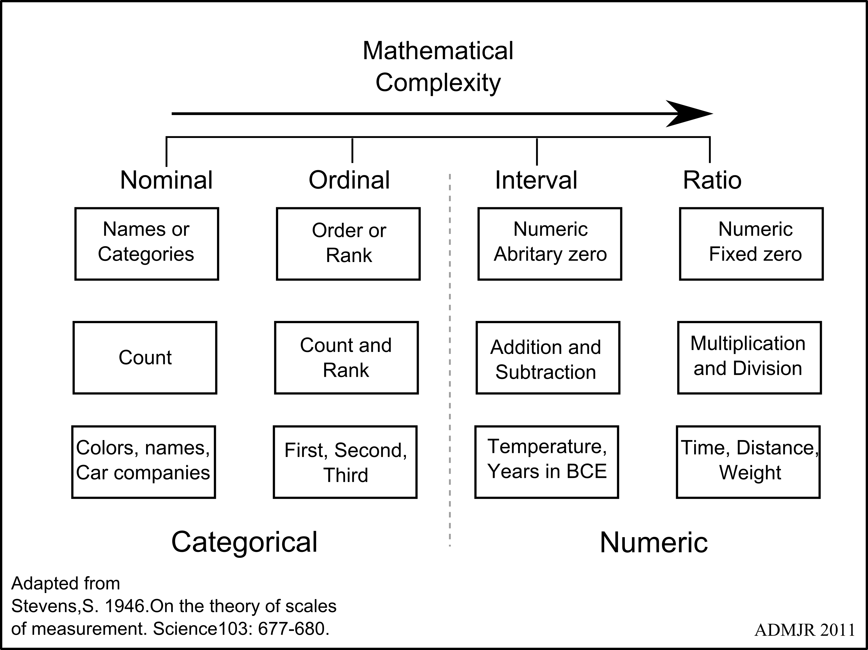
SCALE VS. VARIABLE
MEASUREMENT SCALE
Nominal named groupings, no meaningful order
Ordinal groupings that do have natural order
Interval precise units that are equally spaced
Ratio interval + true zero point
VARIABLE TYPE
Discrete finite, countable number of levels, no intermediate values possible
Continuous infinite intermediate values are possible, at least in theory
NOTE: due to limits on measurement precision,
observed data may be discrete,
even though the underlying construct is continuous

Slide 3
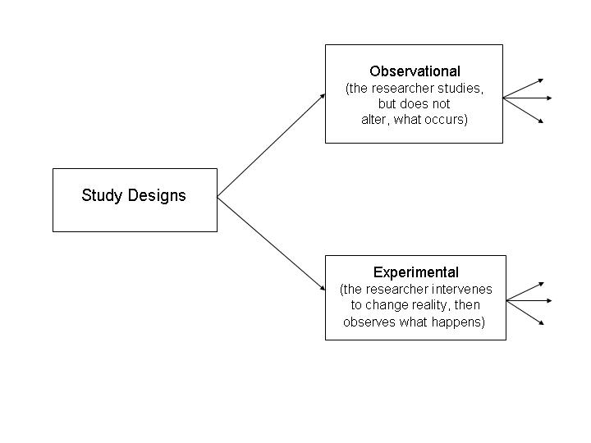
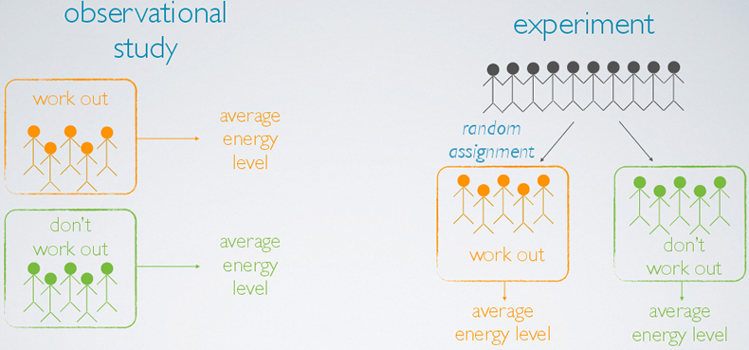
Observational Study vs. Experiment

Slide 4
Rounding off numbers
Round to TWO decimal places
65.3 =
8/3 =
3/8 =
0.4255 =
0.4358 =
0.425 =
0.435 =
65.30
Rules for Rounding
If you want to round to N decimal places,
look at the digit in the N + 1 place…
If it is LESS than 5 → do not change the digit in the Nth place
If it is MORE than 5 → increase the digit in the Nth place by 1
If it is EQUAL to 5 AND there are no non-zero digits to the right, → increase the digit in the Nth place by 1 ONLY IF the Nth digit is ODD (do not change it if it is EVEN)
In all cases, the last step is to drop the digit in the N+1 place and other digits to the right
2.66666… = 2.67
0.375 = 0.38
0.4255 = 0.43
0.4358 = 0.44
0.425 = 0.42
0.435 = 0.44

Slide 5
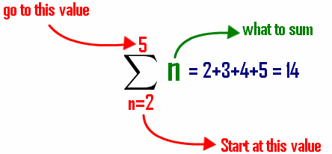


Summation notation
$$Given these values:\left\{\begin{matrix}X_{1}=5, X_{2}=−2, X_{3}=\text{10 } \\ Y_{1}=1, Y_{2}=7, Y_{3}=3 \end{matrix}\right.$$
$\sum_{i=1}^{2}{X_{i}}$ =
$\sum{Y_{i}}$ =
$\sum{{X_{i}}^{2}}$ =
${\left(\sum{X_{i}}\right)}^{2}$=
$\sum{\left(X_{i}∗Y_{i}\right)}$ =
$\left(\sum{X_{i}}\right)$ $∗\left(\sum{Y_{i}}\right)$ =
5 + (-2) = 3
1 + 7 + 3 = 11
25 + 4 + 100 = 129
(5 + -2 + 10)^2 = 13*13 = 169
(5*1) + (-2 * 7) + (10 * 3) = 5 + 5 + 30 = 40
(5 + -2 + 10) * (1 + 7 + 3) = 13*11 = 143
$$= X_{1}+ X_{2}+X_{3}+⋯+ X_{N}$$

Slide 6
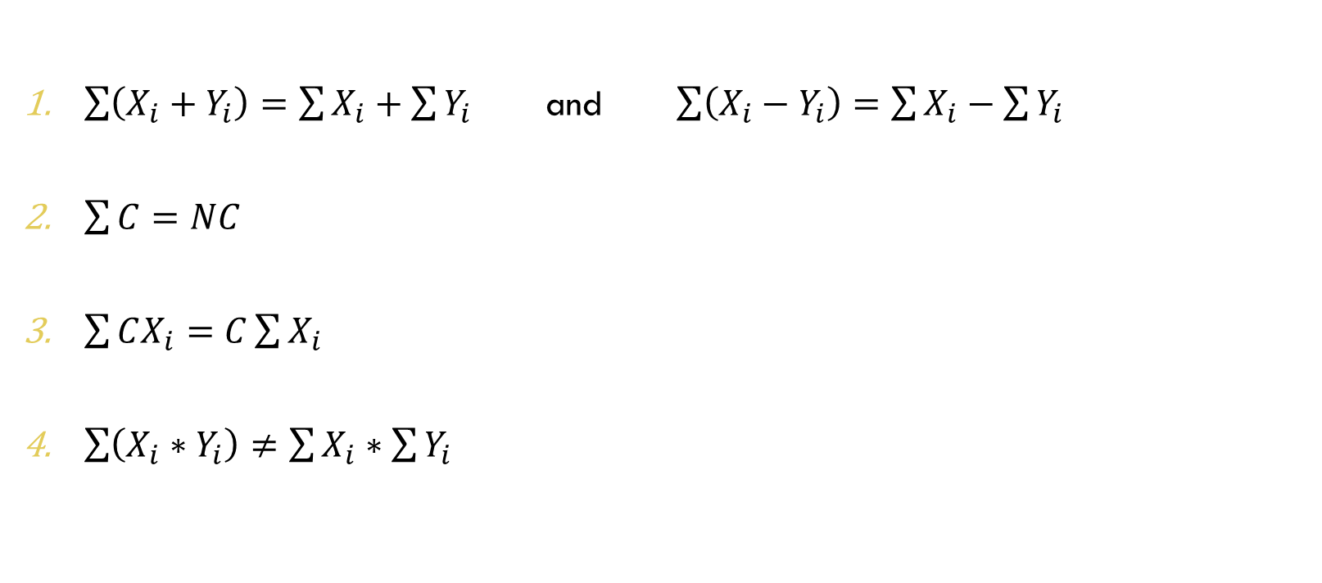
Summation Rules
$\sum{\left(X_{i}+Y_{i}\right)=\sum{X_{i}}+\sum{Y_{i}}}$ and $\sum{\left(X_{i}−Y_{i}\right)=\sum{X_{i}}−\sum{Y_{i}}}$
$\sum{C}=NC$
$\sum{CX_{i}=C\sum{X_{i}}}$
$\sum{\left(X_{i}∗Y_{i}\right)≠\sum{X_{i}}∗\sum{Y_{i}}}$

Slide 7
Spss: STEPS FOR DATASET PREP
Get the data
Prep the data
Variable Labels
Value Labels
Missing Values
Compute new variables and values (fill in missing codes, recode scores, categorize/group values, combine (average, sum, …), etc.)
Use FREQUENCIES to check what is going on

Slide 8
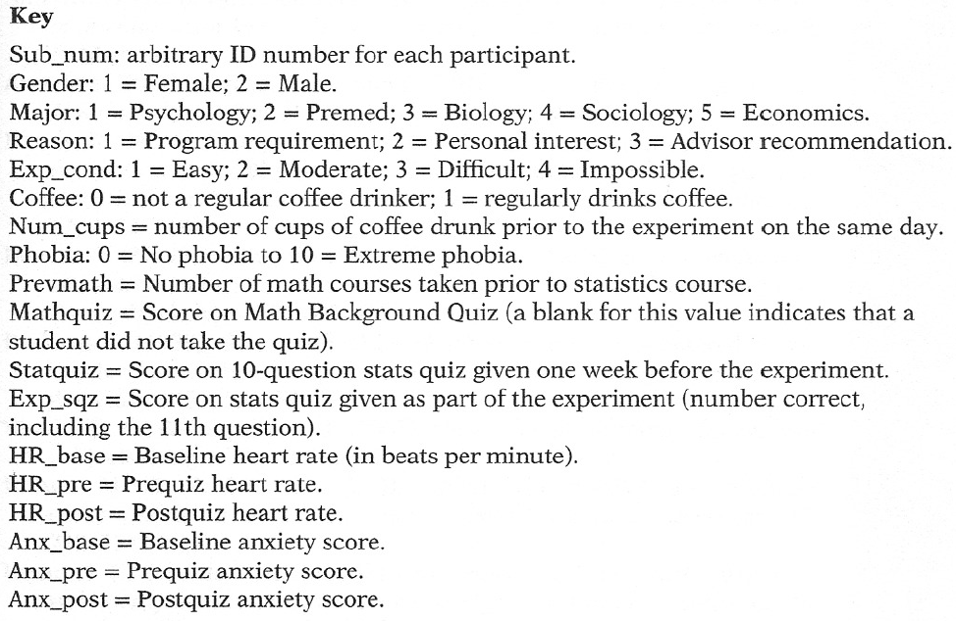
Appendix c: IHNO Data KEY

Slide 9
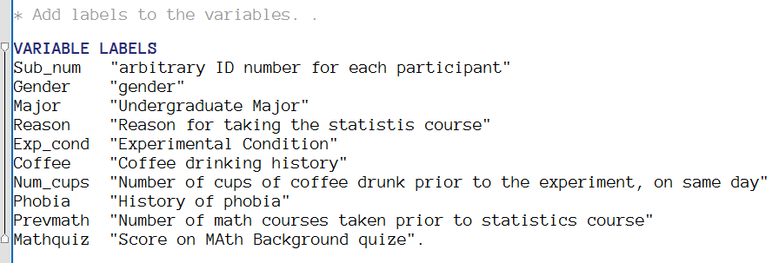
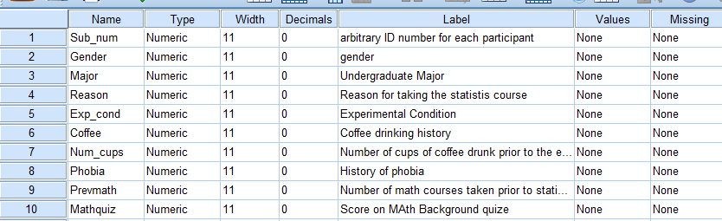
SPSS: specifying variable labels

Slide 10
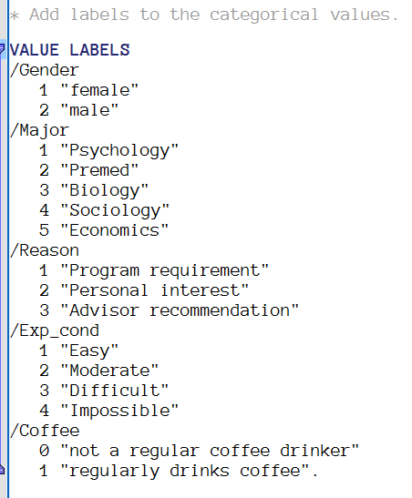
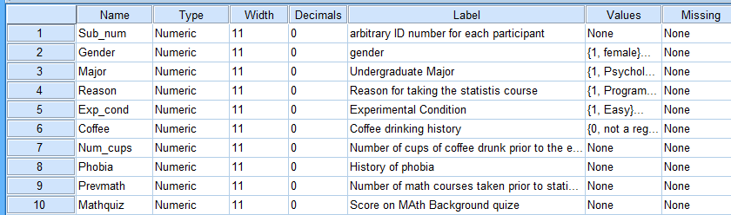
SPSS: specifying Value labels

Slide 11
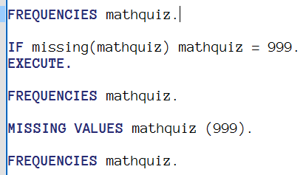
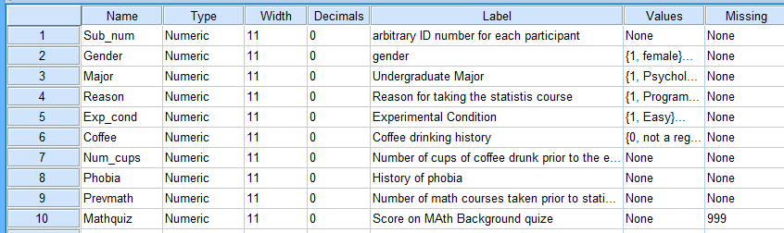
SPSS: declaring missing values

Slide 12
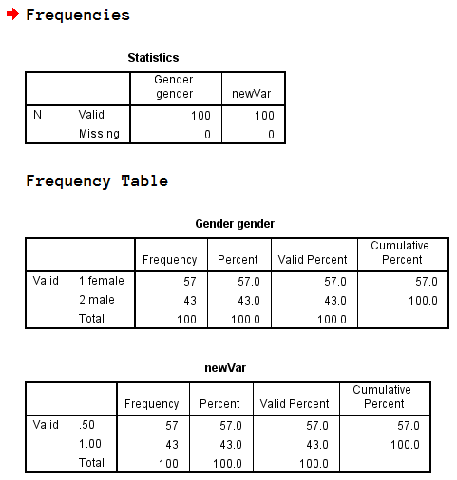
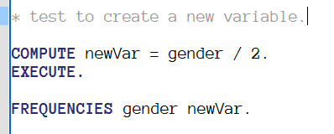
Spss: computing new variables

